Slide 1

DBMS GROUP PROJECT
DATABASE DESIGN FOR A VEHICLE INSURANCE COMPANY
GROUP-2
CSE 4th SEM

Slide 2

DBMS Group Project
TEAM MEMBERS
Mugida Bharadwaz
20BCS087
20BCS125
20BCS126
20BCS128
20BCS129
20BCS137
Somisetty Sai Praneeth
Soumya Ranjan Sahu
Sreedeva Krupananda B Reddy
Sri Hari L Vineeth S R

Slide 3
Group Project Description
Online Insurance is a web application that is used to track details about the insurance policy, customer details, and company details. This project is useful for any kind of insurance company to manage the insurance details, sanction the insurance for the customer, process the insurance policy details, and all kinds of insurance processes online.

Slide 4
GROUP PROJECT OBJECTIVES
The main objective of the Vehicle Insurance is to manage the details of Customers,Vehicle, Insurance, Insurance Period, Registrations. It manages all the
information about Payments, Registrations, insurances. The project is totally built at administrative end and thus only the administrator is guaranteed the access. The purpose of the project is to build an application program to reduce the manual work for managing the Customers, Vehicle, Payments, Insurance. It tracks all the details about the Insurance, Insurance Period, Registrations.

Slide 5

SOFTWARE:

Slide 6
E R
D I A G R A M

Slide 7
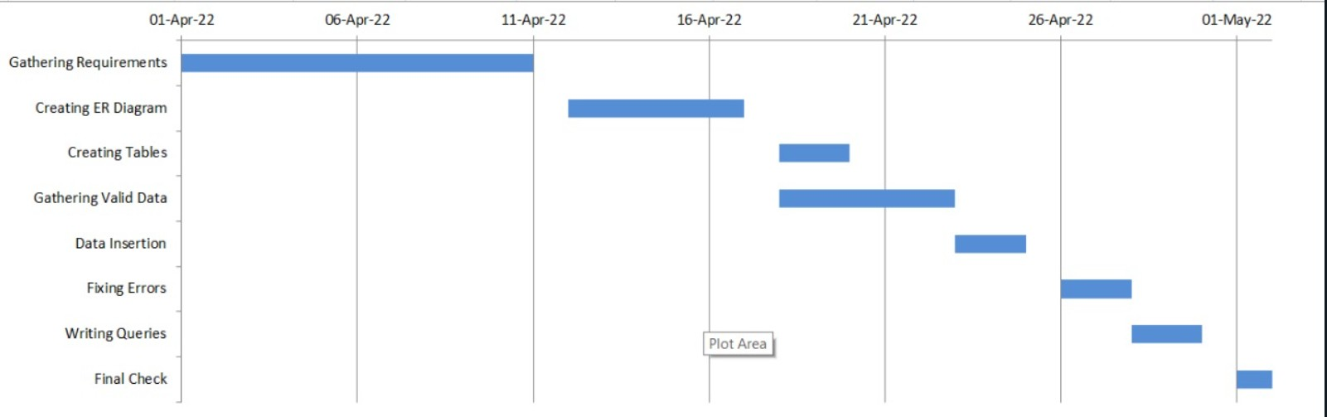
TIMELINE:

Slide 8
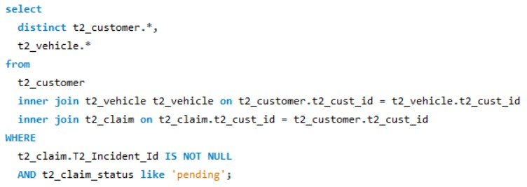
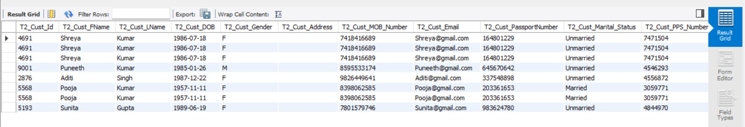
Query-1
Retrieve Customer and Vehicle details who has been involved in an incident and claim status is pending – Customer, vehicle, claim status, incident

Slide 9
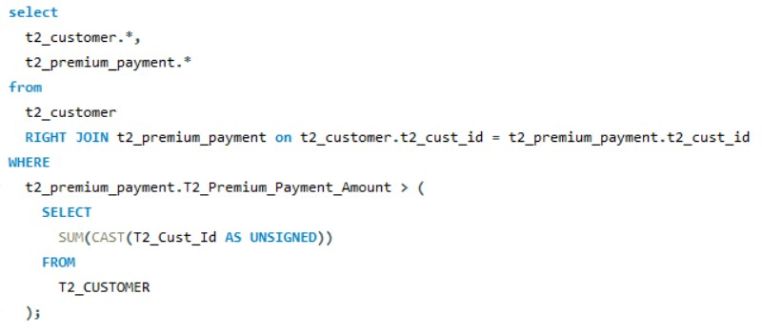
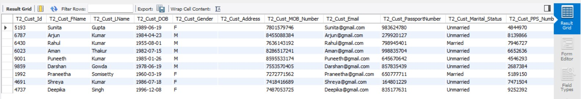
Query-2
Retrieve customer details who has premium payment amount greater than the sum of all the customerIds in the database – premium payment, customer

Slide 10
Query-2
Retrieve customer details who has premium payment amount greater than the sum of all the customerIds in the database – premium payment, customer

Slide 11
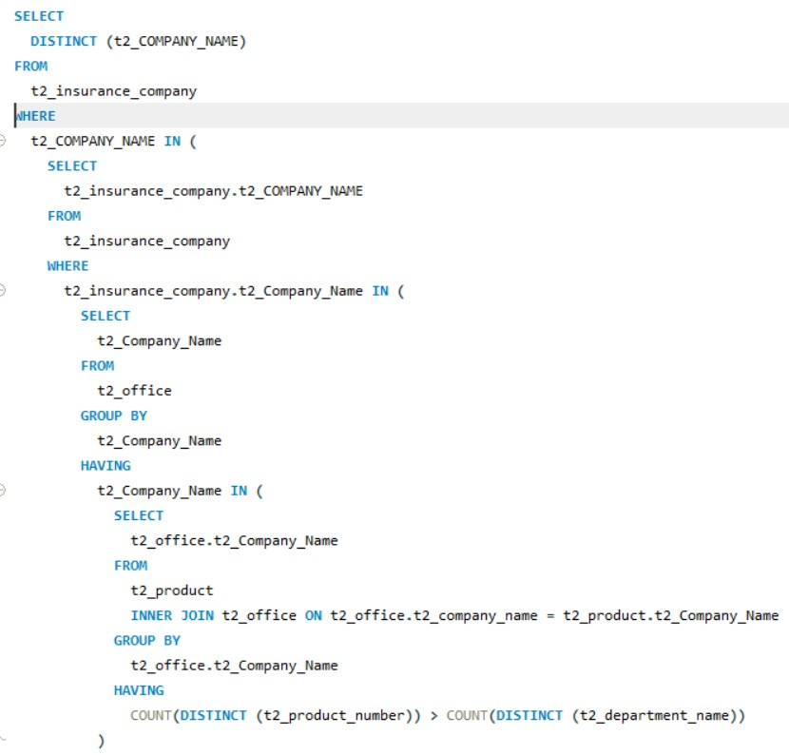
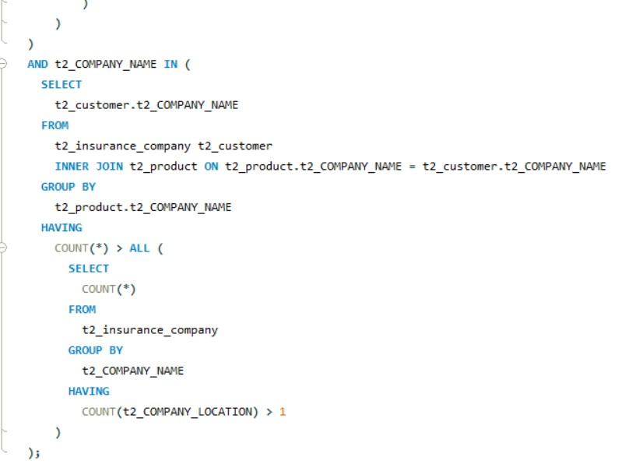
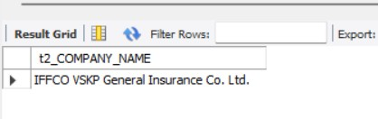
Query-3
Retrieve Company details whose number of products is greater than departments, where the departments are located in more than one location—company, product, departments, office

Slide 12
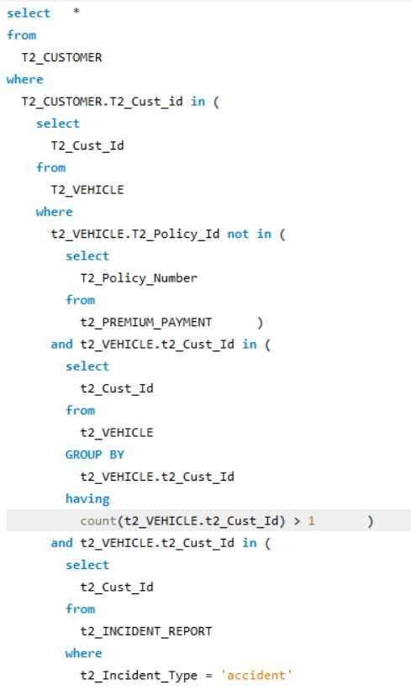
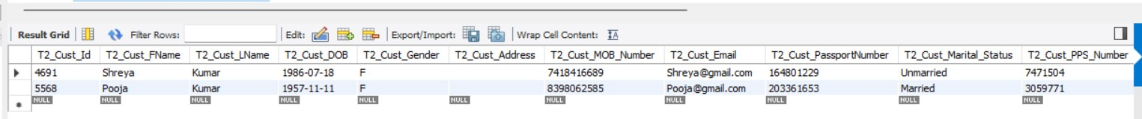
Query-4
Select Customers who have more than one Vehicle, where the premium for one of the Vehicles is not paid and it is involved in accident

Slide 13
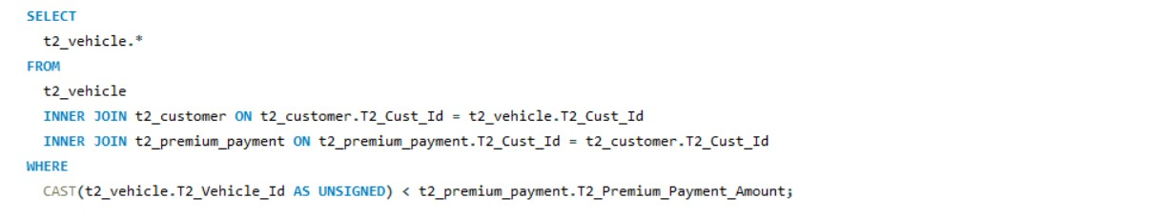
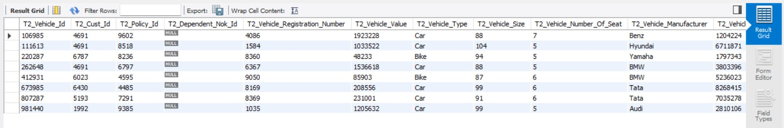
Query-5
Select all vehicles which have premium more than its vehicle number.

Slide 14
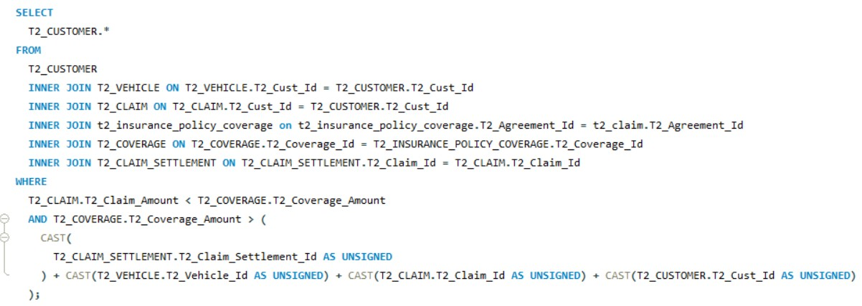
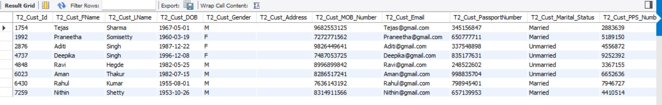
Query-6
Retrieve Customer details whose Claim Amount is less than Coverage Amount and Claim Amount is greater than Sum of (CLAIM_SETTLEMENT_ID, VEHICLE_ID, CLAIM_ID, CUST_ID)

Slide 15
Thank you

